Slide 1
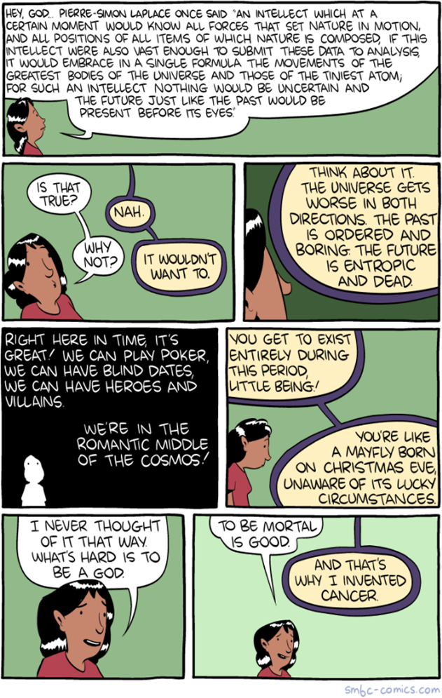
Non-Linear Dynamics
ME 357
Notes:
This will be more conceptual than previous units
We will see why we focus on linear systems and the difficulties introduced by nonlinearity

Slide 2
Objectives
By the end of this section, you should
Understand how non-linear systems may behave much differently than linear systems
Trajectories can vary wildly due to small changes in initial values or parameters
Understand what phase plane/space is and how it is created
Understand what is meant by chaos and how it differs from “randomness”

Slide 3
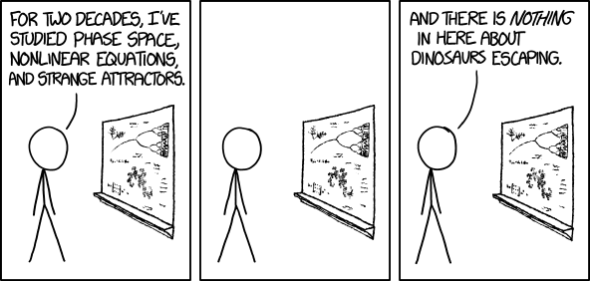
Continuous Nonlinear Systems
Can represent in state space form but not with matrices
Transfer functions (as we use them) not going to work
Solving systems analytically typically difficult
Numerical solution may work
Can linearize system around equilibrium points
Can use averaging methods
Systems may be chaotic
Small changes in initial conditions or parameters lead to large changes in response (sensitivity to initial conditions)
Notes:
Topics for later courses

Slide 4
Phase Plane/Space
Can study and visualize dynamics of system by looking at phase plane/space
Plot state variables against each other with time as parameter
Can assess behavior near stability points by stable/unstable and spiraling/non-spiraling

Slide 5
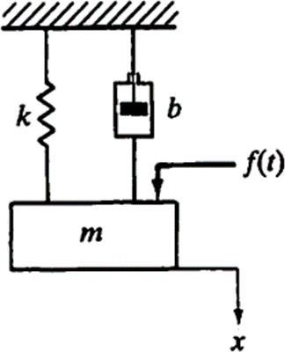
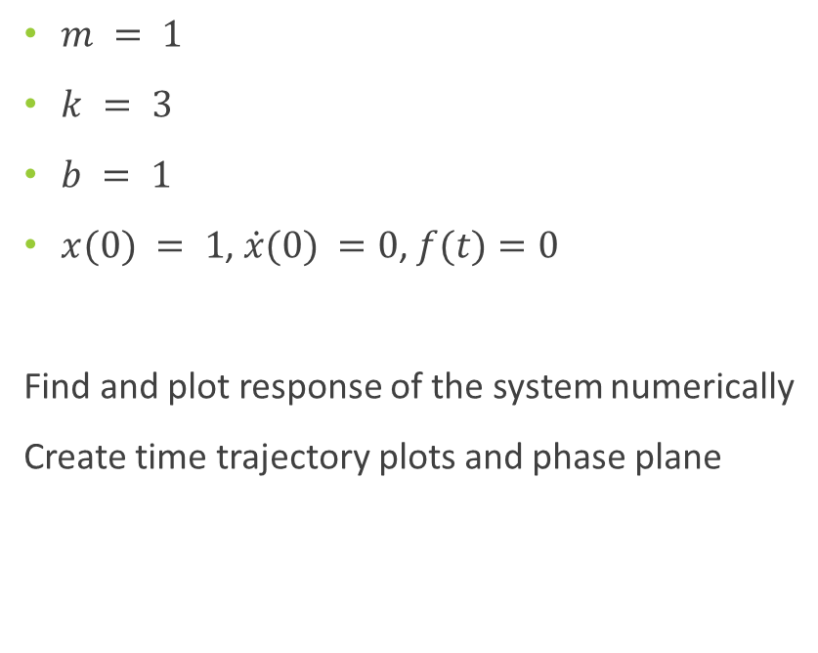
Phase Plane Example
$m = 1$
$k = 3$
$b = 1$
$x(0) = 1$, $\dot{x}(0) =0$, $f(t)=0$
Find and plot response of the system numerically
Create time trajectory plots and phase plane

Slide 6
Phase Plane Example
Time Traces
Phase Plane
Notes:
Starting at x(0) = 1, v(0) = 0

Slide 7
Perturbations
What happens if ICs change a little?
What if parameters change?
Notes:
Starting at x(0) = 1, v(0) = 0

Slide 8
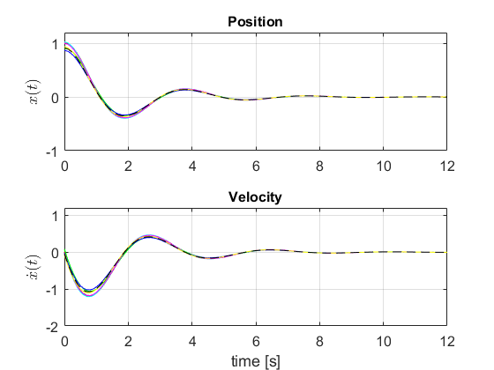
Small Change in ICs
Time Traces
Phase Plane
Notes:
Slightly different ICs
All go to “sink”

Slide 9
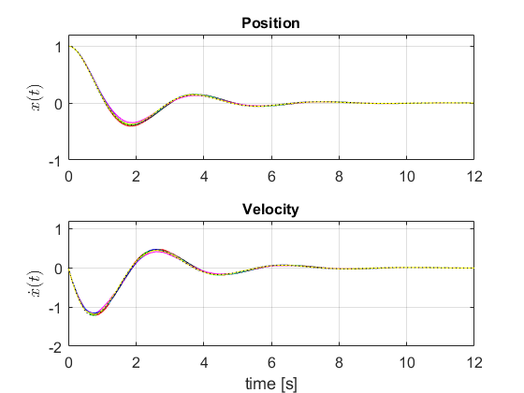
Small Change in Parameters
Time Traces
Phase Plane
Notes:
Slightly different ICs
All go to “sink”

Slide 10
Discussion
In real system, ICs or parameters could be measured or set inaccurately or imprecisely
“Small” differences in ICs or parameters in linear system did not have “large” impact on system and died out over time
Trajectories were different but converged given enough time
Will hold analysis to autonomous systems for now and not consider external forcing
Notes:
Starting at x(0) = 1, v(0) = 0
“Small” and “large” are nebulous terms here

Slide 11
If you do not give people an example, they do not understand the point
If you do give an example, they think the example is the point

Slide 12
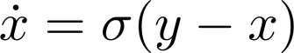
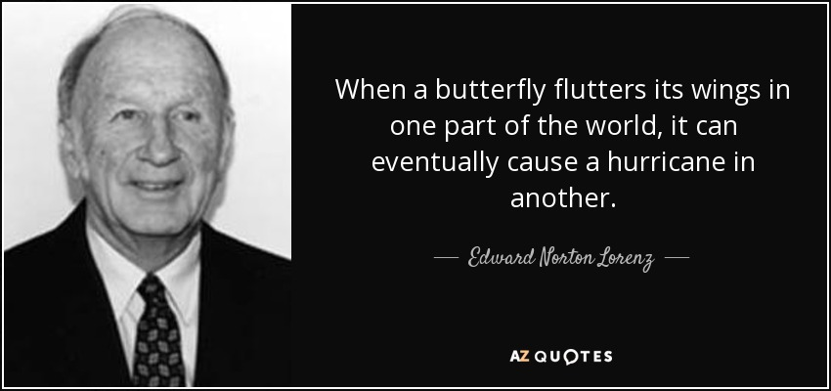
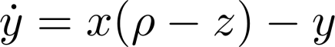
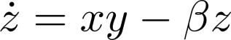
Lorenz System
https://www.technologyreview.com/s/422809/when-the-butterfly-effect-took-flight/
Notes:
this example is the first highly-studied nonlinear system
\rho, \beta, \sigma are constants
This is a simplified version of the weather equations. The meanings of the states is not important for this but we could think of them as temperature, air pressure and humidity perhaps. Let’s assume that days are the base unit of time
On a winter day 50 years ago, Edward Lorenz, SM ‘43, ScD ‘48, a mild-mannered meteorology professor at MIT, entered some numbers into a computer program simulating weather patterns and then left his office to get a cup of coffee while the machine ran. When he returned, he noticed a result that would change the course of science.
The computer model was based on 12 variables, representing things like temperature and wind speed, whose values could be depicted on graphs as lines rising and falling over time. On this day, Lorenz was repeating a simulation he’d run earlier—but he had rounded off one variable from .506127 to .506. To his surprise, that tiny alteration drastically transformed the whole pattern his program produced, over two months of simulated weather.
The unexpected result led Lorenz to a powerful insight about the way nature works: small changes can have large consequences. The idea came to be known as the “butterfly effect” after Lorenz suggested that the flap of a butterfly’s wings might ultimately cause a tornado. And the butterfly effect, also known as “sensitive dependence on initial conditions,” has a profound corollary: forecasting the future can be nearly impossible.

Slide 13
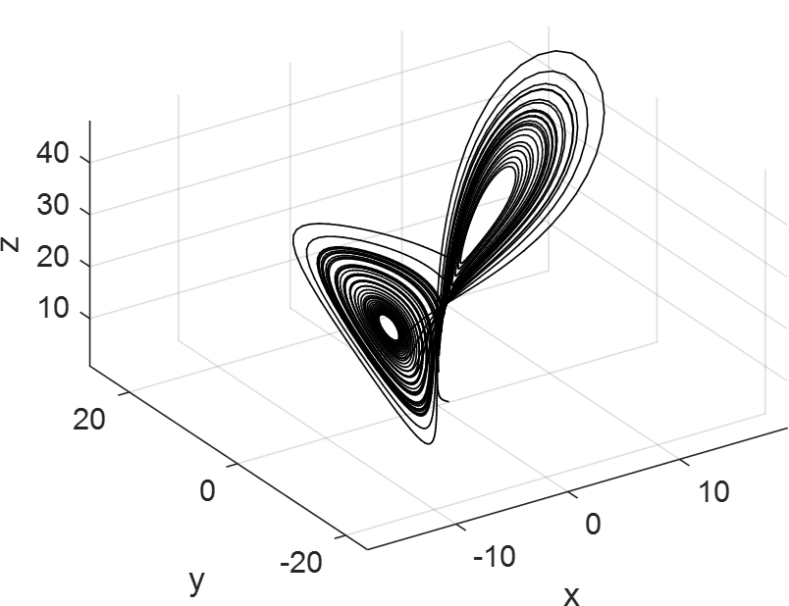
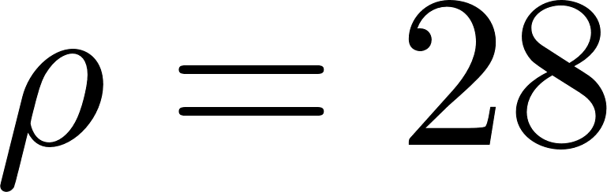

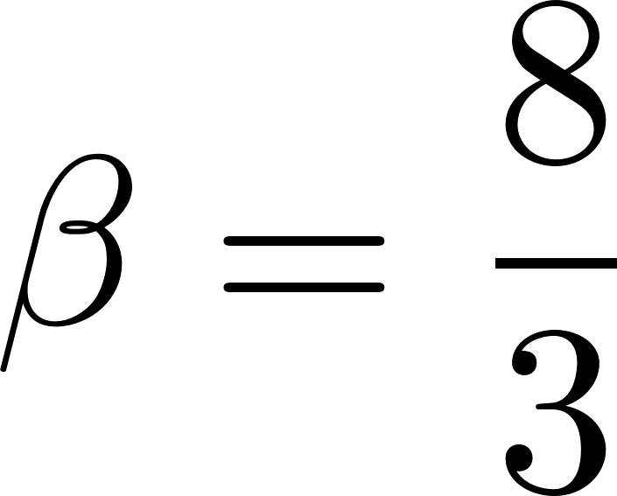
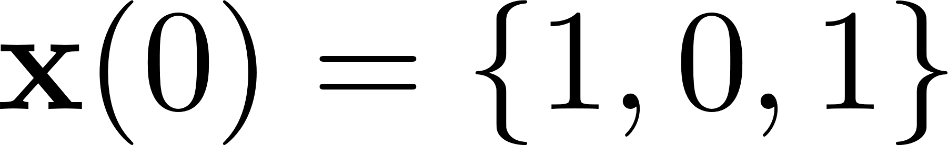
Lorenz System Typical Phase Space
Notes:
Will use these parameters values for the rest of the example
Run for t = 50

Slide 14
Perturbations
Our instruments have finite precision so we will have errors in our initial temperature, air pressure and humidity measurements
What happens if ICs change a little?
Our parameter estimates will have error
What is the parameters slightly change?
Notes:
Starting at x(0) = 1, v(0) = 0

Slide 15


Lorenz System Animation Varying $x(0)$
https://youtu.be/7-OXifmAYl0
Notes:
initial conditions vary *slightly*

Slide 16

Time Series Comparison Slightly Varying $x(0)$

Slide 17

Time Series Comparison Slightly Varying $ρ$

Slide 18
Discussion (1)
Varying only one initial condition or parameter (even very slightly) caused solution to diverge over time
As time went forward, divergence became larger
Likely have deviations on all ICs, inputs and parameters
Only random element was value of IC, dynamics of system are deterministic
Get same trajectory every time given the same ICs
In linear systems, small changes in initial values or parameters lead to small changes in output
If we can make estimate of our error on input we can get PDF of output value
Can determine chance that it falls between an upper and lower bound
Monte Carlo simulation
Notes:
The solution has nothing random in it
Why is estimating weather difficult?

Slide 19
Estimating Under Uncertainty
If we can quantify our uncertainty in initial conditions and modeling parameters, can quantify uncertainty in estimate
Develop probabilities of values our states will have in the future
Can do this numerically using Monte Carlo simulation
Choose thousands/millions of random start points, simulate system and record results
Maps input distribution to output distribution for system
More simulations typically results in better estimation

Slide 20
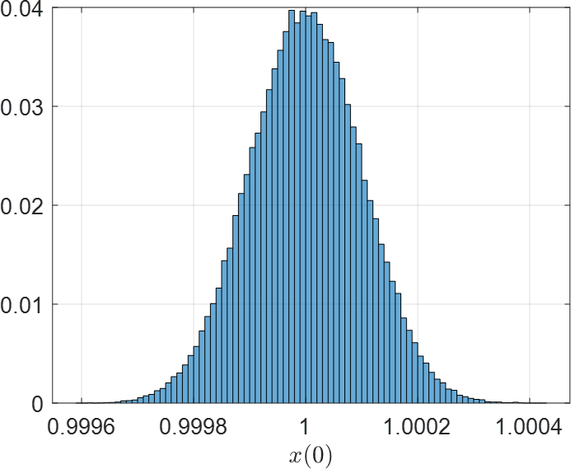
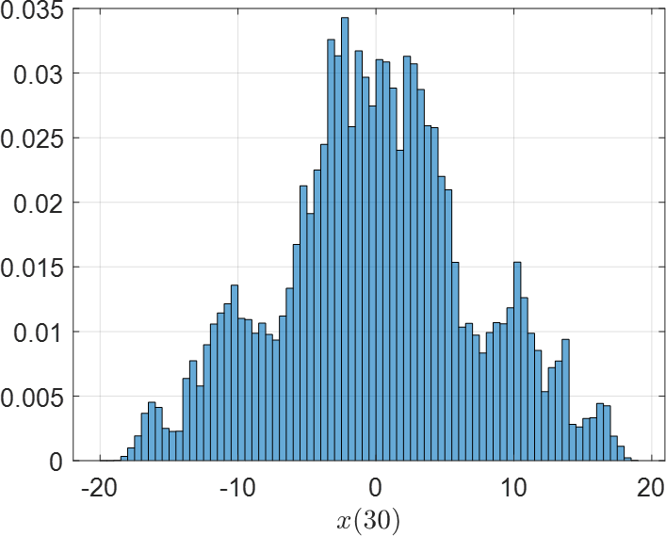
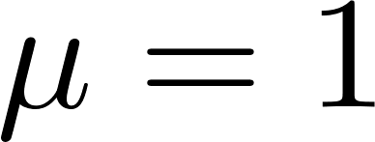
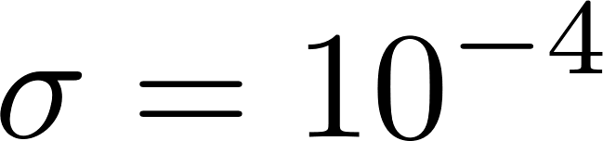

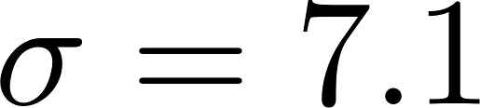

PDF of $x(0)$ vs $x(30)$
Notes:
Small variance on IC leads to large variance 30 seconds out
Only showing x(t) here, not y(t) and z(t)

Slide 21
Convergence of Mean
Notes:
flattening indicates convergence of results and we ran "enough" samples

Slide 22
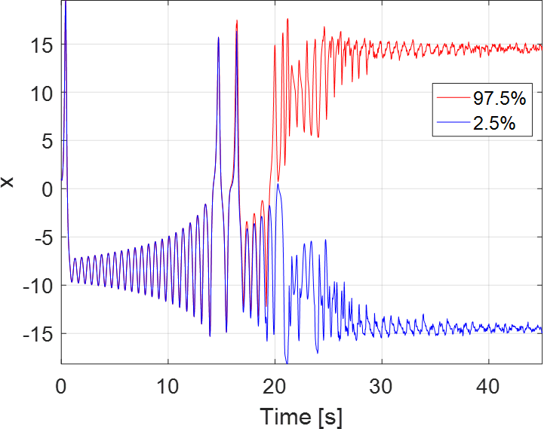
95% Confidence Bounds
Notes:
close bounds until 20s

Slide 23
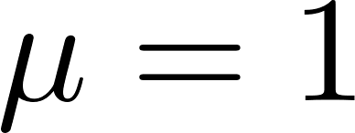
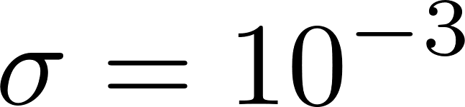
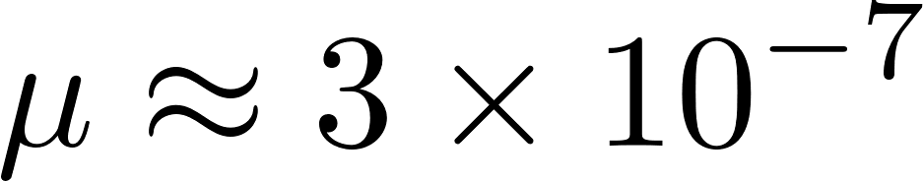
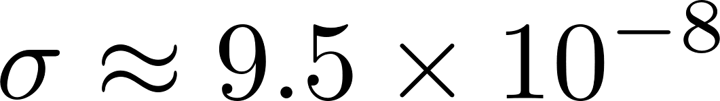
Linear System Behavior (SMD)
Notes:
Give small perturbation of ICs, m, k and b in this linear system, barely impacts the SS value at 30 seconds: not chaotic
Despite IC, converges within small range, probably numerical artefact and should be ~0

Slide 24
95% Confidence Bounds
Notes:
cannot observe any real difference

Slide 25
Discussion (2)
With enough simulations, can find probability distribution of output value in non-linear system
Able to bound estimate over time
Can express confidence of value in range over time
Must be aware that model has assumptions and simplifications; initial conditions and parameters do not have infinite precision
Precision not nearly as important in linear systems
Note: this system is “highly chaotic” at these parameter values and does not represent “typical” nonlinear system
Notes:
Why is it difficult to predict weather? We have been trying for 1000s of years
Why is it difficult to predict climate change or agree on economic policy?

Slide 26
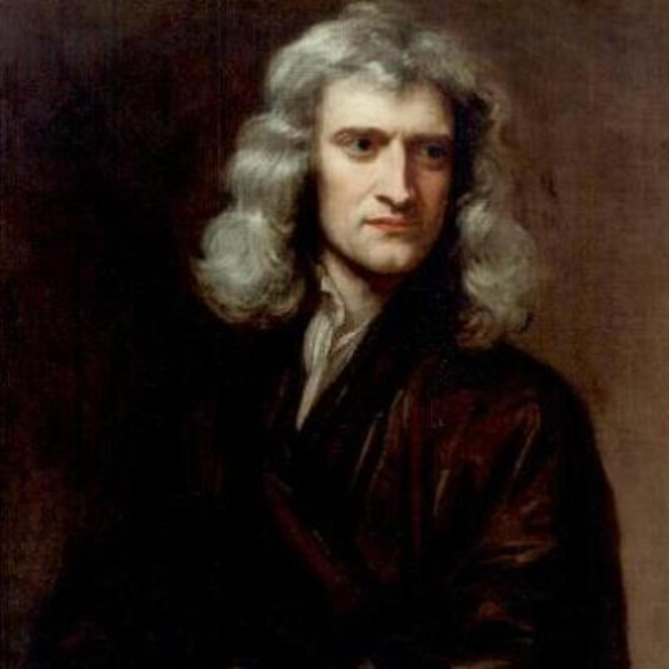
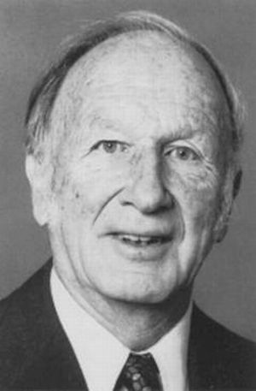

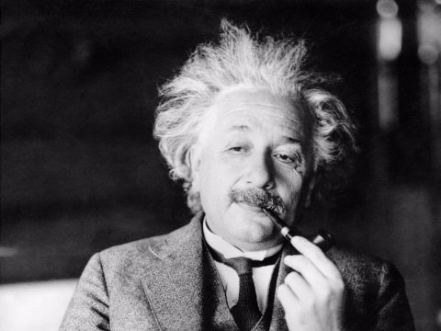
A Clockwork Universe?
Notes:
Newton tries to calculate motion with simple equations – clockwork universe: if we know all the ICs and parameters, we can calculate out the future
Einstein: “I, at any rate, am convinced that He [God] does not throw dice”– are things random as Quantum Physics claims?
Chaos is not random, just high complexity. The “small” uncertainty in model lead to “large” uncertainty in the predictions

Slide 27
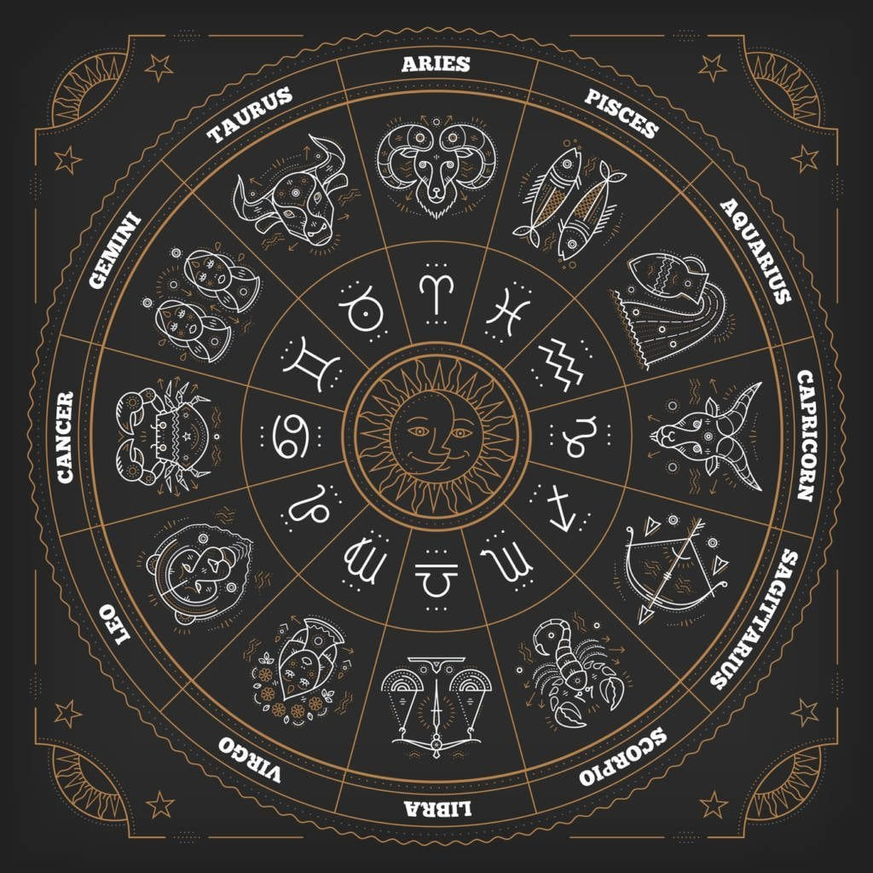
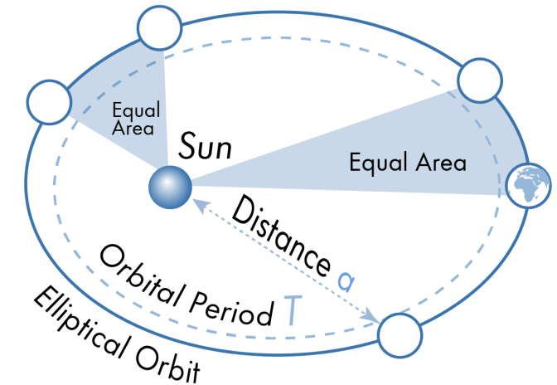
Turning the Wheel of Time
Notes:
Why do we want to know the future? In ancient times, need to know when to best plant crops, go to war etc. This could be done by observation and “statistics”.
If we believe our fortunes, crop yields, health are determined by the placement stars and planets, it would be advantageous to know how they will be aligned in the future. Look at Mayan calendars, through Kepler in “early” to “modern” efforts of modeling the heavens. Once aspect of dynamic, engineering, science, man endeavors is predicting and untimely having a control of the future.

Slide 28
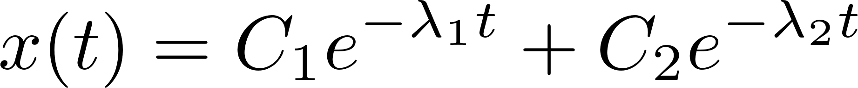
Turning the Wheel of Time
Notes:
Newton built on Kepler’s planetary observations and built models based on differential equations, marrying math and physics. The motion of the heavens were governed by the same laws as things on Earth. Newton was a believer of the “clockwork universe” and spent most of his later career studying the Bible and alchemy.
If we know our ICs we can solve (analytically or numerically) for our states in the future. We can make models of all kinds of systems changing in time. Assume the model is (nearly) perfect, we can predict the future. What if we were really good at modeling: we could model physics, biological, chemical, thermal, etc. systems that change in time.

Slide 29
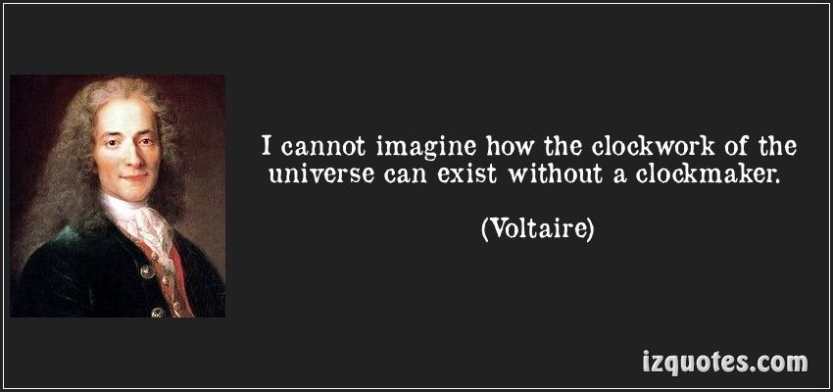
Turning the Wheel of Time
Notes:
What if we could model the big bang and knew the ICs: can we turn the crank through the past to present day to the future and know all motions?

Slide 30

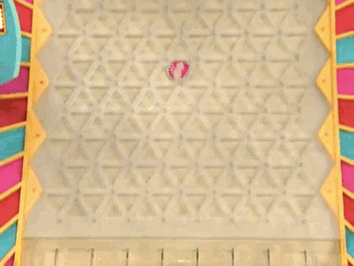
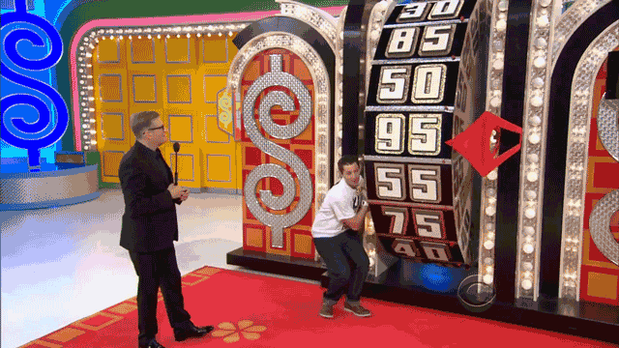
Randomness
Notes:
Are some things that we perceive as “random” really so? The activities do not involve random elements, just physics. If we had good models of the system (the wheel and dice are not too hard) and we knew the IC’s and BC’s, we would know the result every time. Plinko appears random, but really it is just very sensitive to the initial conditions. Give it the exact same IC’s (and model) 1000 times and the results will be the same each time. It is complex, but not random: the outcome appears random without deeper scrutiny. These may be pseudo-random processes as they are really deterministic in nature.
Even in the Matlab simulations, rng made using Mersenne Twister creates “random numbers”

Slide 31
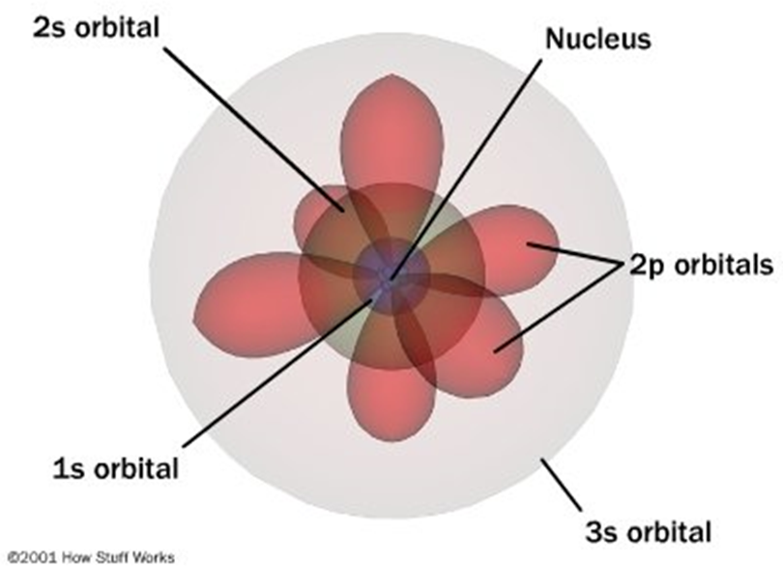

Quantum & Randomness
Notes:
Roughly: quantum mechanics says that the location of an electron is random in the atom. Processes at the atomic level are random. Until we observe the result, the system is in superposition in all possible states.
Classical mechanics is large-scale version of quantum mechanics

Slide 32
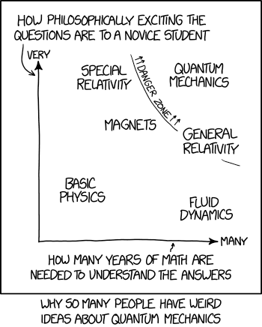
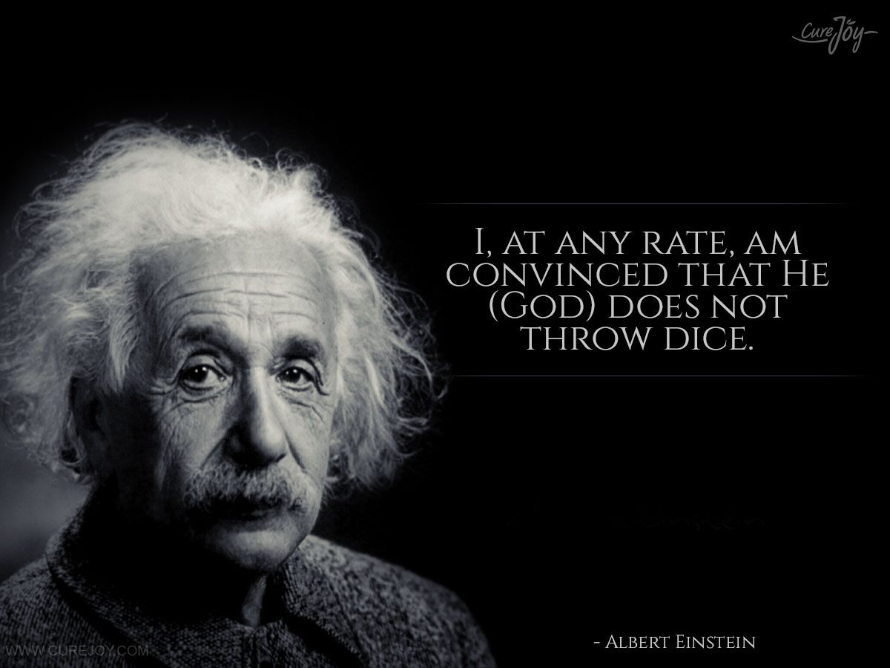
Quantum & Randomness
Notes:
A philosophical component of QM is that the state only converges once it is observed.
Albert Einstein, himself one of the founders of quantum theory, did not accept some of the more philosophical or metaphysical interpretations of quantum mechanics, such as rejection of determinism and of causality. He is famously quoted as saying, in response to this aspect, "God does not play with dice".^{[77]} He rejected the concept that the state of a physical system depends on the experimental arrangement for its measurement. He held that a state of nature occurs in its own right, regardless of whether or how it might be observed. In that view, he is supported by the currently accepted definition of a quantum state, which remains invariant under arbitrary choice of configuration space for its representation, that is to say, manner of observation. He also held that underlying quantum mechanics there should be a theory that thoroughly and directly expresses the rule against action at a distance; in other words, he insisted on the principle of locality. He considered, but rejected on theoretical grounds, a particular proposal for hidden variables to obviate the indeterminism or acausality of quantum mechanical measurement. He considered that quantum mechanics was a currently valid but not a permanently definitive theory for quantum phenomena. He thought its future replacement would require profound conceptual advances, and would not come quickly or easily. The Bohr-Einstein debates provide a vibrant critique of the Copenhagen Interpretation from an epistemological point of view. In arguing for his views, he produced a series of objections, the most famous of which has become known as the Einstein–Podolsky–Rosen paradox.

Slide 33

Chaos & Complexity
Notes:
In linear systems, our imprecision in measuring our IC’s or parameters is not a big deal: small errors lead to small errors. However, as we saw in the example, our inability to achieve infinite precision will impact our predictions out of non-linear – especially chaotic – systems
This lies somewhere in-between viewpoints. Maybe nature is largely or wholly deterministic but chaotic. We could predict anything in the future but would require a perfect model and infinite precision.

Slide 34
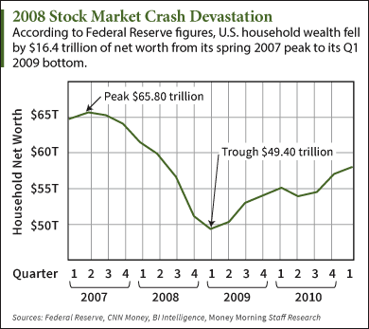
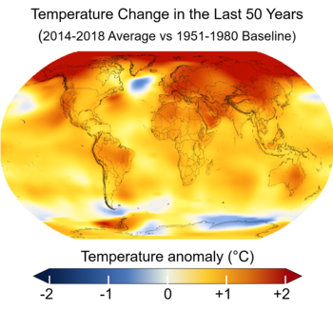
Chaos & Complexity
Notes:
Why is it so hard to make predictions of complicated systems?
Even if our model (the “physics” part) is perfect (it is not), we cannot overcome the inherent problem of imprecision of IC and parameters. Small errors upfront lead, potentially, to large errors later. As we have seen, the further out we go, the worse the reliability becomes.

Slide 35
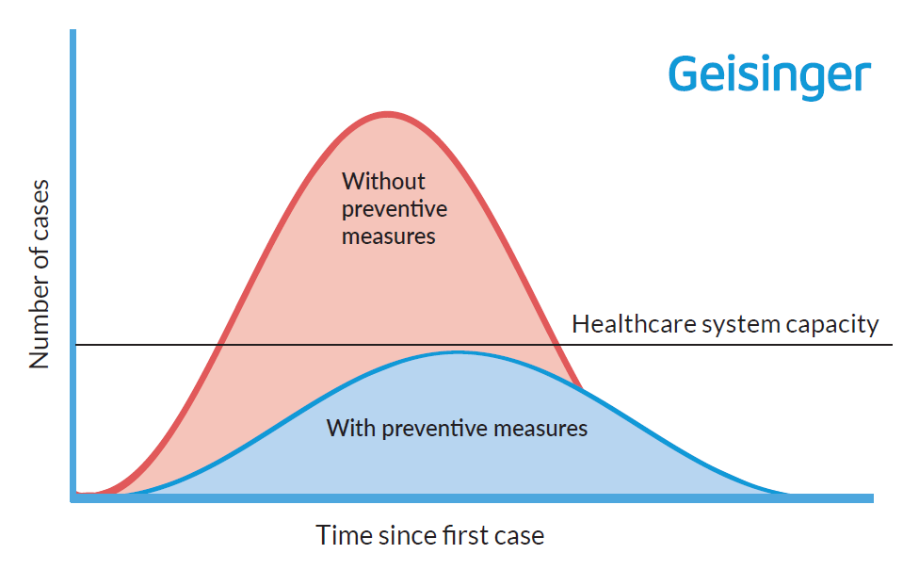
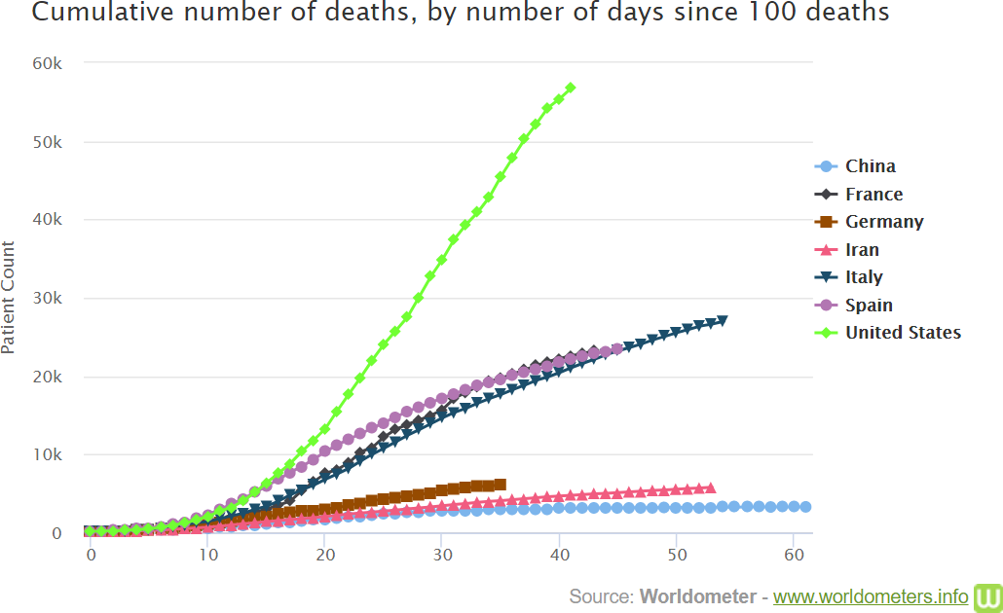
Chaos & Complexity
Notes:
at time of recording (late April 2020), the campus is closed due to COVID19. Practicing social distancing
https://www.geisinger.org/health-and-wellness/wellness-articles/2020/03/18/16/20/covid-19-what-does-flattening-the-curve-mean?utm_source=organicsocial-facebook&utm_medium=socialmedia&utm_campaign=covid19
https://www.worldometers.info/coronavirus/worldwide-graphs/#countries-cases

Slide 36
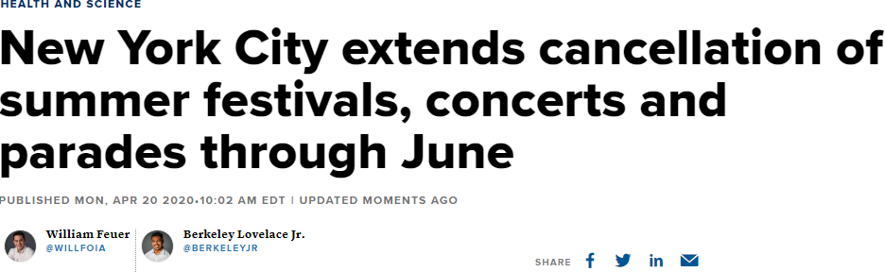


Chaos & Complexity
Notes:
Not to simplify the model to much
“Not as many as predicted”
“overblown fear”
Using SIR (suspectable-infectious-recovered/removed) models
models are not perfect. Need to be updated. Do not know the initial conditions nor current state. Not sufficient testing to have accurate data for the model

Slide 37
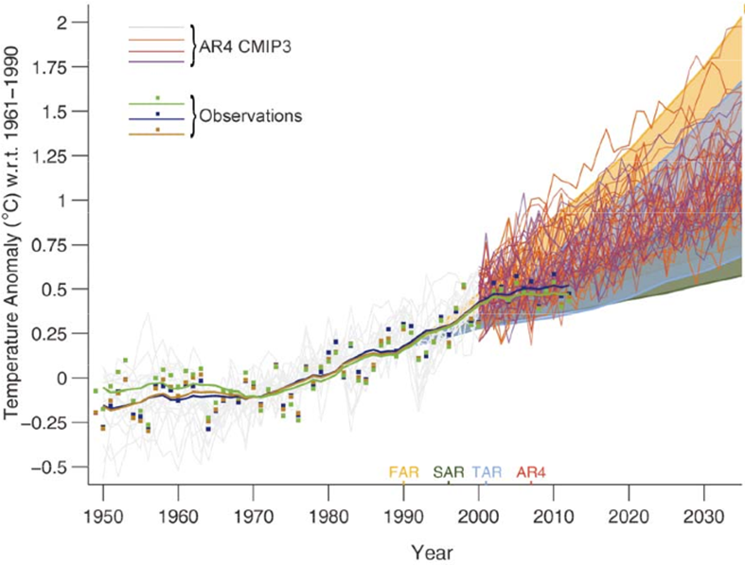
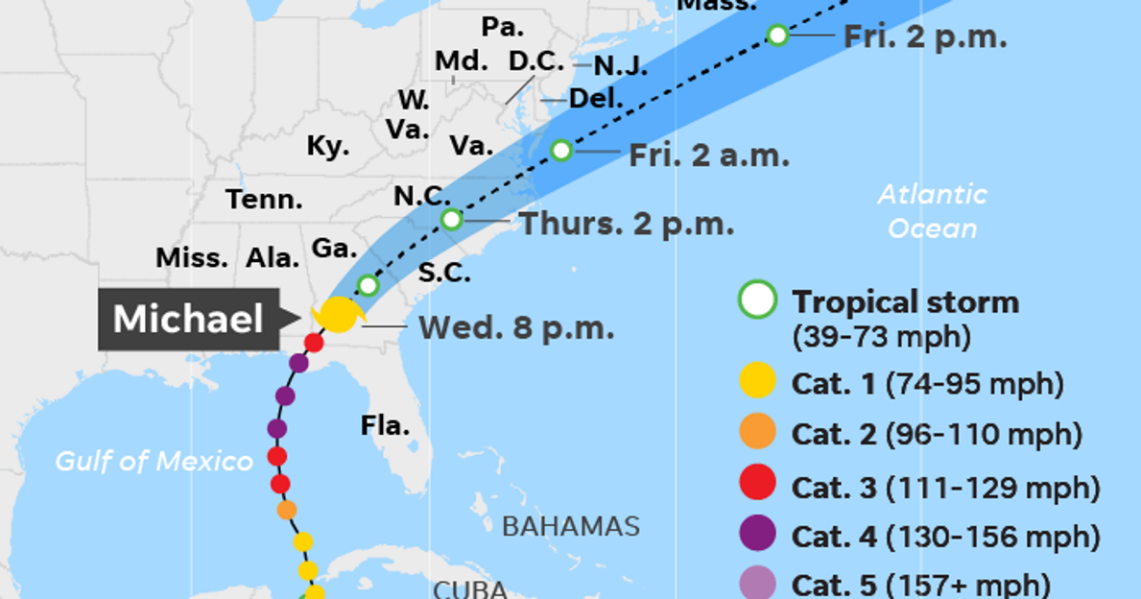
Chaos & Complexity
Notes:
Why are predictions of climate change in a range and not concrete? We have to estimate how much error we have upfront (see previous examples) and then we can get a distribution of future values. These ranges are acknowledging our fallibility, not trying to hide it.
The models – and their inputs – are updated as time goes on. Thus, the predictions will change. Typically, our short-range estimates will lie in a tighter confidence interval and using today’s data will give a better estimate than using yesterday’s.
https://news.psu.edu/story/569285/2019/04/15/research/predictability-limit-scientists-find-bounds-weather-forecasting?utm_source=newswire&utm_medium=email&utm_term=569322_HTML&utm_content=04-15-2019-22-11&utm_campaign=Penn%20State%20Today

Slide 38
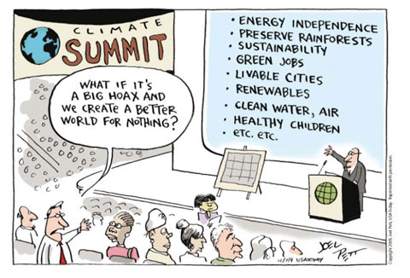
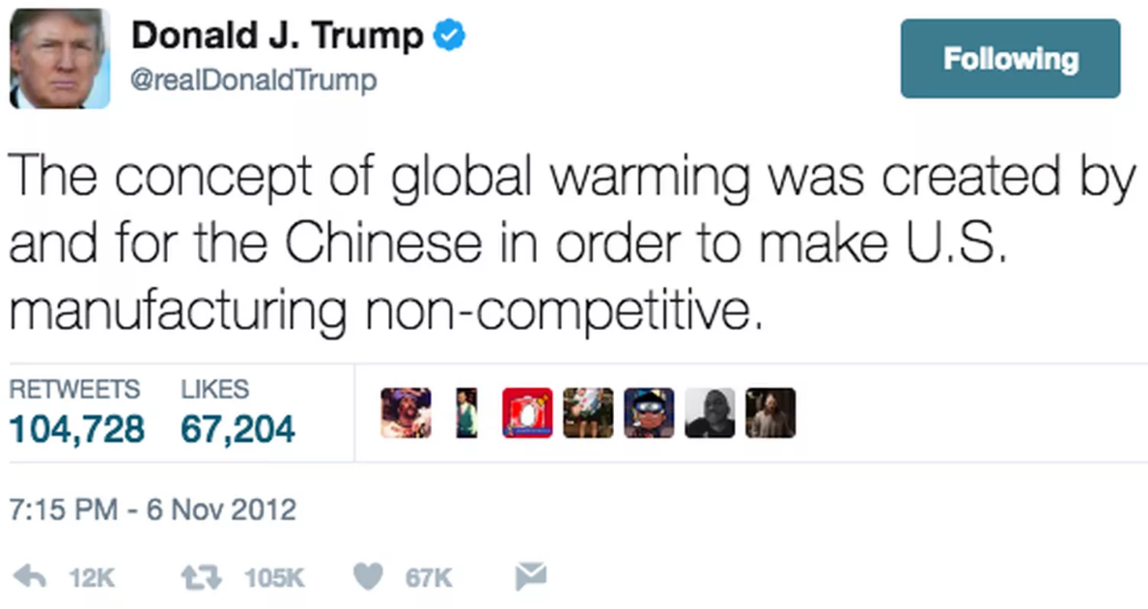
Chaos & Complexity
Notes:
Predicting the future is hard. The models can be –and are – wrong. Models certainly contain “bias.” Our measurements are inaccurate and imprecise.
Should we not make predictions because they may be wrong? This is the best we can do, the models and predictions inform us even if they are not 100% correct.

Slide 39
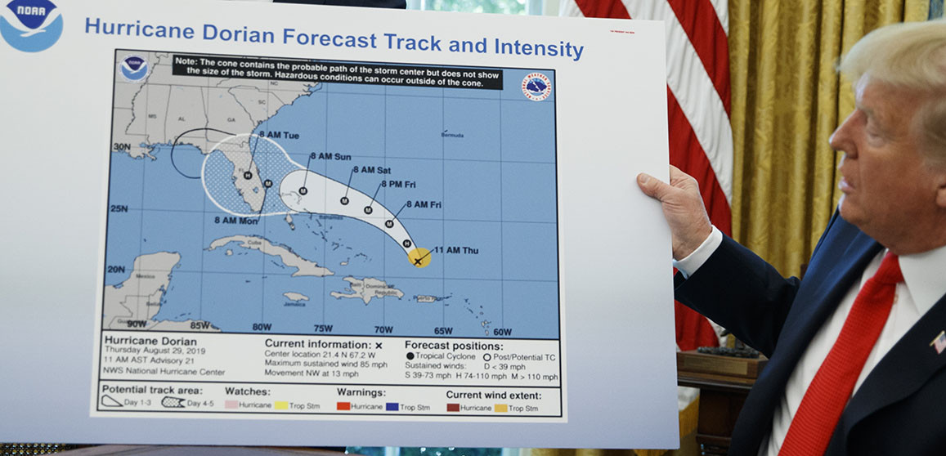
Bad Predictions?
Predictions often give band of estimates
Updating when time comes will update future estimates

Slide 40
Updating the Estimate

Slide 41
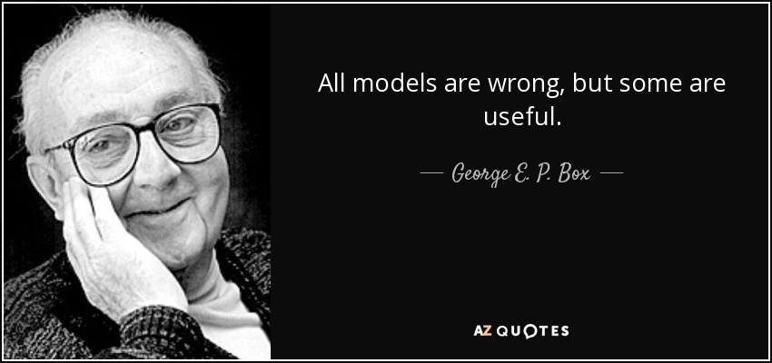
Chaos & Complexity
Notes:
Predicting the future is hard. The models can be –and are – wrong. Models certainly contain “bias.” Our measurements are inaccurate and imprecise.
Should we not make predictions because they may be wrong? This is the best we can do, the models and predictions inform us even if they are not 100% correct.

Slide 42
Why Should We Care?
Bachelor of Science
…not a Bachelor of “Making Stuff”

Slide 43
Discrete Mappings
Instead of continuous system, can analyze discrete systems
Get each value using previous value(s)
These type of systems can appear in mechanics (e.g., Poincaré sections) and biological systems (e.g., predator-prey)
Though deterministic, system can appear random
Will look at system becoming chaotic

Slide 44
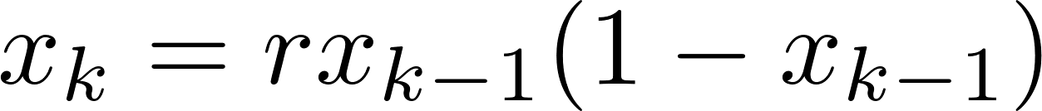
Logistic Map
Common example of discrete map
Can capture elements of population dynamics (birthrate or starvation)

Slide 45
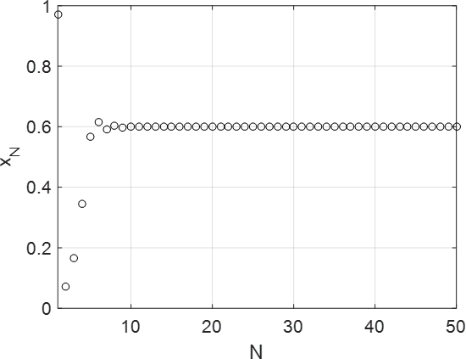
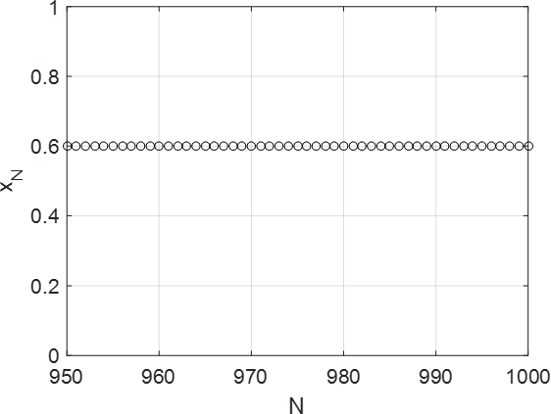
Time Series
r = 2.5
r = 2.5

Slide 46


Time Series
r = 3.2
r = 3.2

Slide 47


Time Series
r = 3.5
r = 3.75

Slide 48


Time Series
r = 3.85
r = 4

Slide 49


Time Series
r = 4*
r = 4**

Slide 50

Random Time Series

Slide 51


Structured or Random?
Histogram
Correlation

Slide 52


Structured or Random?
Histogram
Correlation

Slide 53

Bifurcation Diagram
Notes:
For several random initial conditions at each r-value, plot the value of x(1500) [steady-state].
This shows the periodic orbits that we observed earlier.

Slide 54



Stability Analysis of a Linear System

Slide 55

Linearization
Recall Taylor Series Expansion for function:
Truncate series after first derivative:
where $x0$ is an equilibrium point (all derivatives of state variables are zero in autonomous system)
Can be one, many or infinite equilibrium points
Analyze motion “close” to equilibrium point
Error will increase as we move away from equilibrium point

Slide 56




Duffing Oscillator Autonomous
ODE
Write in state-space form
Find Jacobian of system
Find equilibrium point(s) where all derivatives are zero

Slide 57




Duffing Oscillator Autonomous
Evaluate Jacobian at each equilibrium point
Assess local stability near each equilibrium point by looking at eigensystems

Slide 58


Phase Plane

Slide 59


Phase Plane

Slide 60

Phase Plane

Slide 61
Limit Cycles
In autonomous nonlinear system, states do not have to go to infinity (unstable) or settle at one value (stable system)
Seen in Lorenz system
Position and velocity (if mechanical) can fall into limit cycle

Slide 62




Van der Pol Oscillator
ODE
Write in state-variable form
Find Jacobian of system
Find equilibrium point where all derivatives are zero

Slide 63


Van der Pol Oscillator
Evaluate Jacobian at equilibrium point
We can assess local stability near each equilibrium point by looking at eigensystem

Slide 64

Stability

Slide 65


Phase Portraits
μ = 0.2
μ = 1

Slide 66

Phase Portraits
μ = 2
μ = 4

